Slide 1
Instructions
Have a seat, but leave your items (laptop, notebook, etc) in your bag
Now you have to move seats
Across the aisle
To a different row then you’re currently in
And to a different row then either of your current neighbors
Back row: you just have to move up
Now I will assign group numbers
Each side / each row is a group
Back row is a group
In a moment you can introduce yourselves
Somebody needs to document your group number

Slide 2
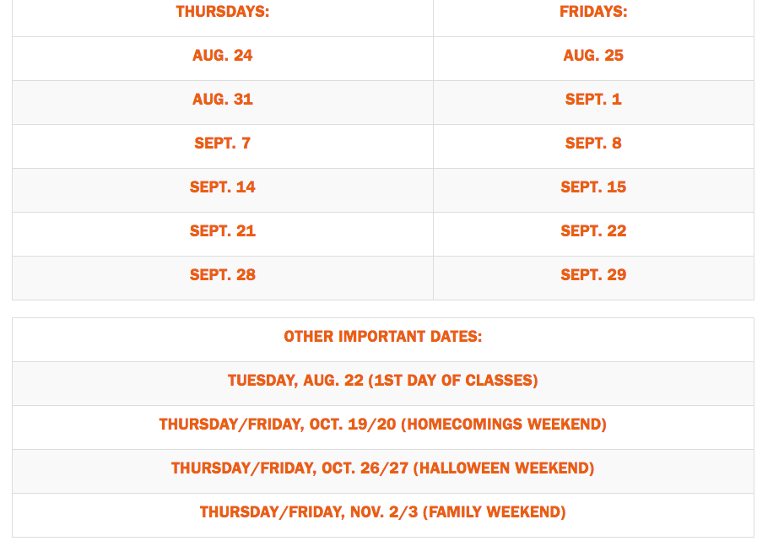
#HOOSGOTYOURBACK

Slide 3
Assignment
Somebody from group should get a picture of this slide
As a group:
Find the highest building at UVA
Find the biggest building at UVA
Rules:
You have until 1:25PM to get back into your current seat
Honor code – you cannot speak with anybody in this class outside of your group (including TAs, Fleming)
Deliverables:
You will be expected to present your findings to the class
You must create some “artifact” for Fleming and TAs to document your findings in our grading system
Expect a lively Q&A when you present!!!

